Slide 1

TMWA Booster Pump Station Special Use Permit
(WSUP19-0009
Board of Adjustments

Slide 2
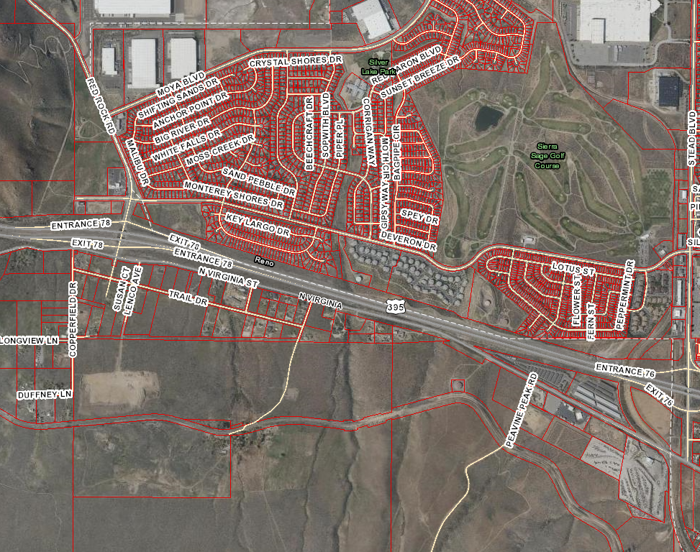
Vicinity Map
Red Rock Road
N. Virginia Street
Sierra Safari Zoo

Slide 3
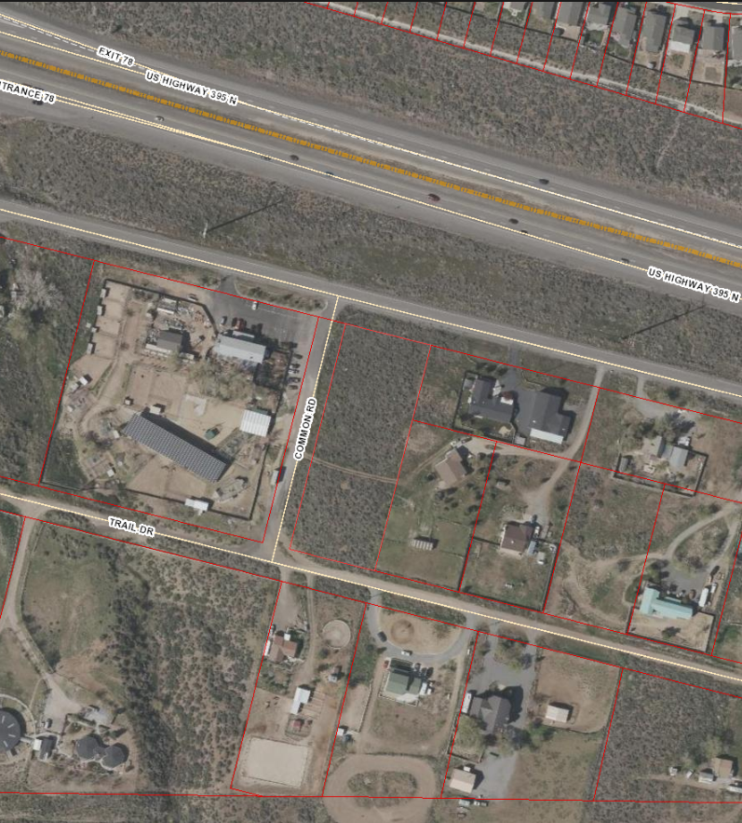
Site Considerations
Road Adjacency
Residential Adjacency
Size of Lot
N. Virginia Street
Sierra Safari Zoo
Common Road
Trail Drive

Slide 4
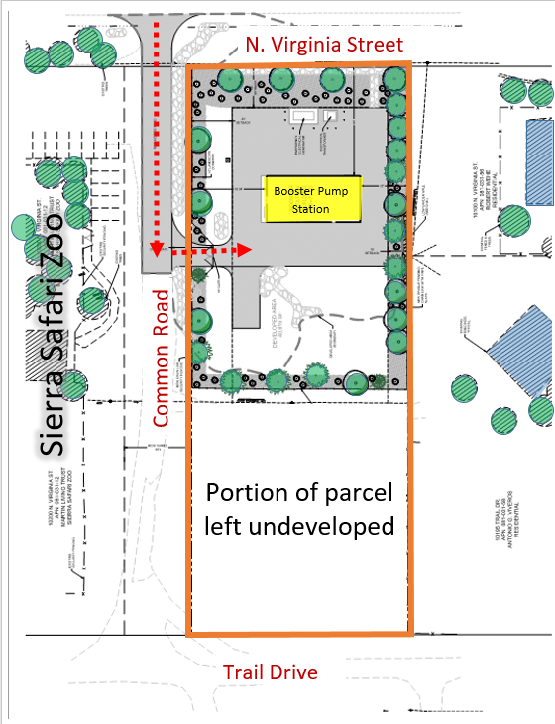
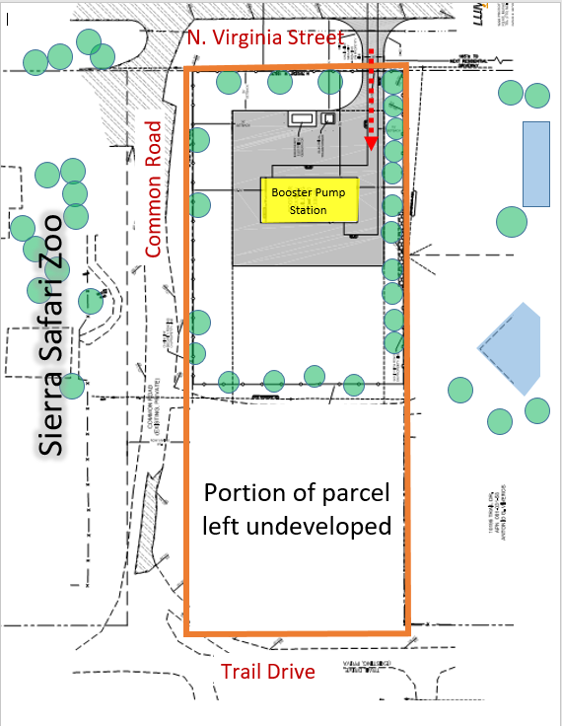
Access Alternatives
Access Alternative - A
Access Alternative - B

Slide 5
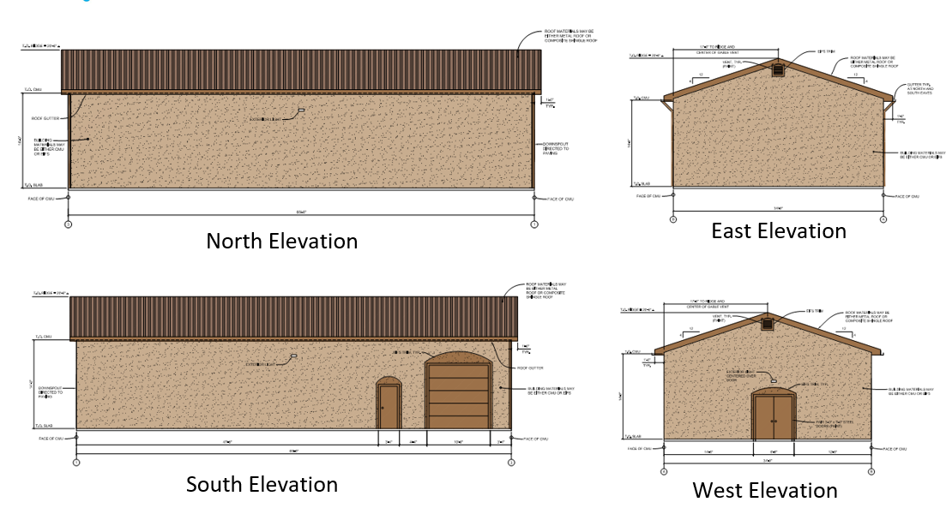
Residentially Compatible

Slide 6
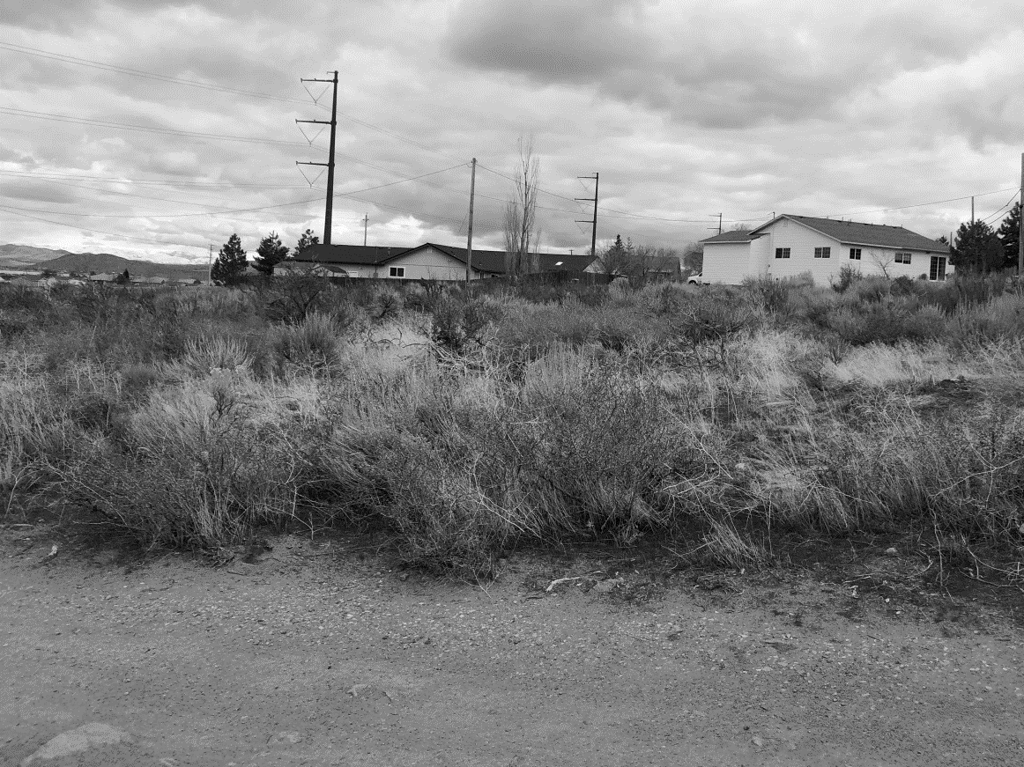
Questions?

